Slide 1
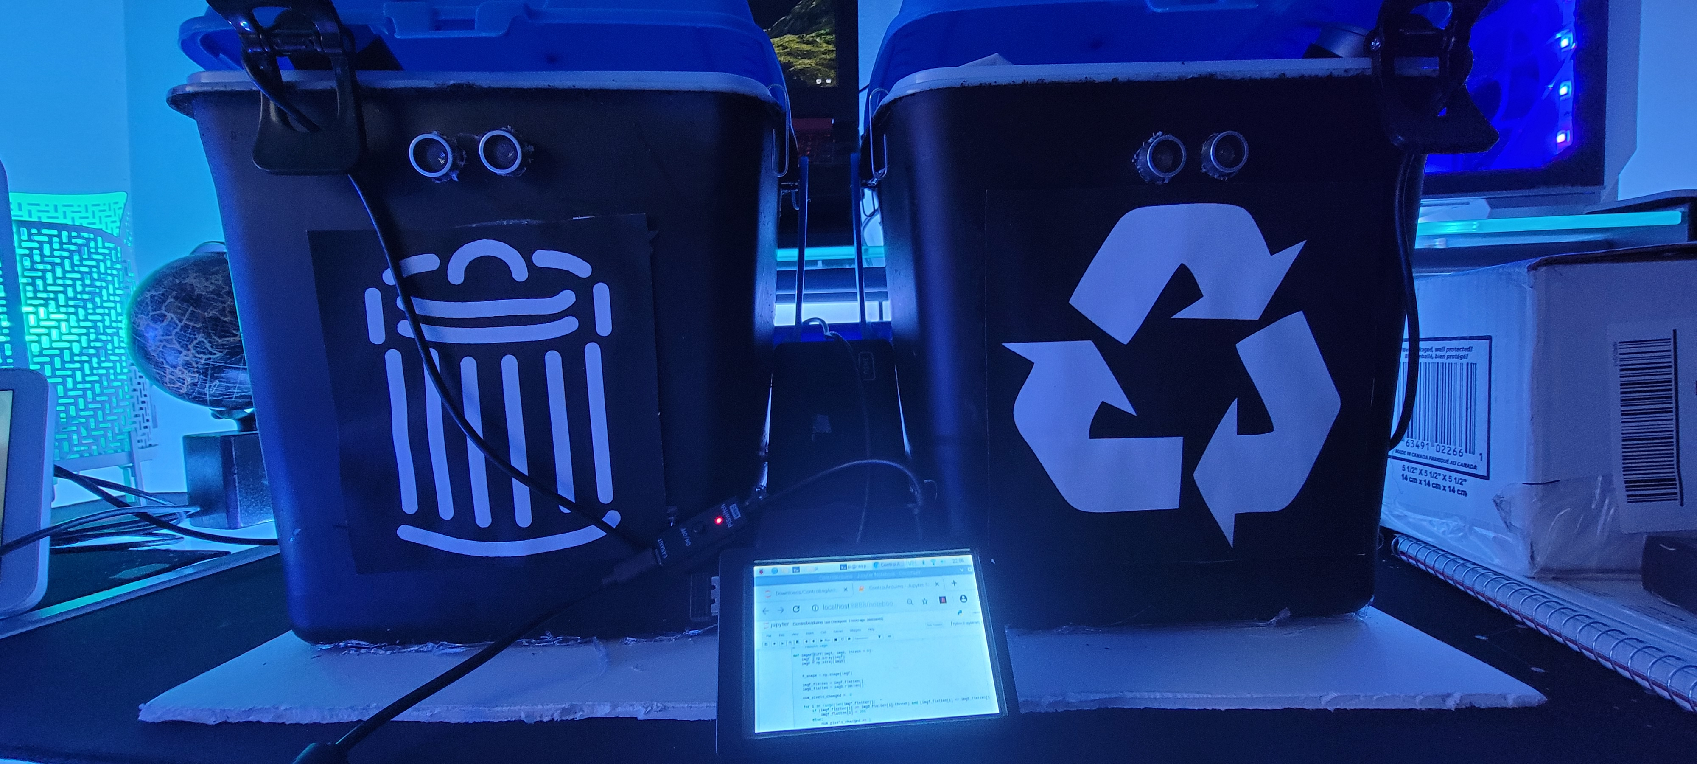
Proposal: Trash Sorting with smart Gamification PuBelle
Khalil Nijaoui
Wassim Nijaoui

Slide 2
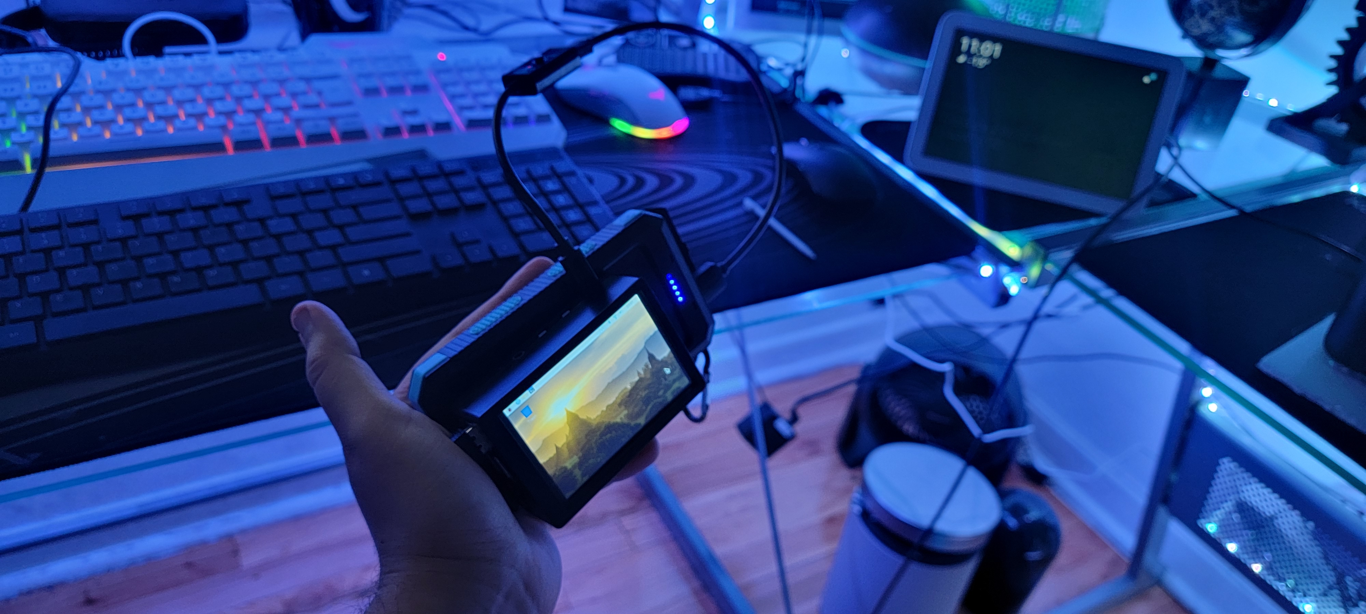
Introduction
Gamification consists of adding game mechanics into nongame environments. Such an approach can be seen with “social scores” in China, “Credit scores” around the world. This approach aims to motivate people by giving them a purpose and a “physical” score that can decline or improve according to their actions. Thus, making them more self-aware and carful about their actions.

Slide 3
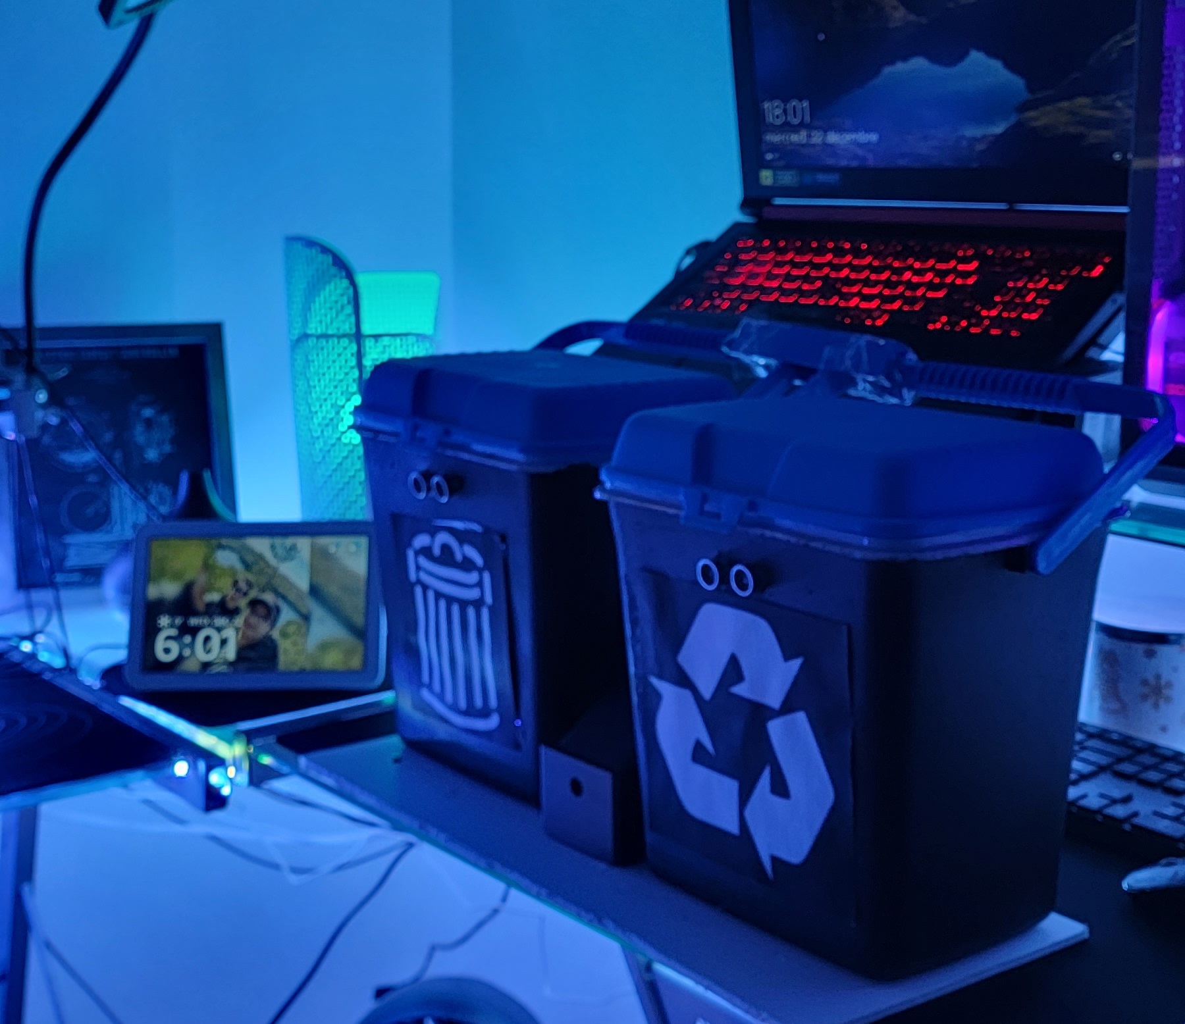
Introduction
For that sole purpose we want to explore the utility of the idea by motivating users to do the same action that they do on daily basis with the hope of getting prizes if they do it right. Prizes can be provided by sponsors or in-app items in the future such as trophies.

Slide 4
Problems to solve
Preform Image processing on board to determine the type of the thrown objects
Have a robust state of the art trash bin Hardware wise
1
3
2
Create a website where points can be stored using state of the art technology
4
Keep the costs and the complexity low

Slide 5
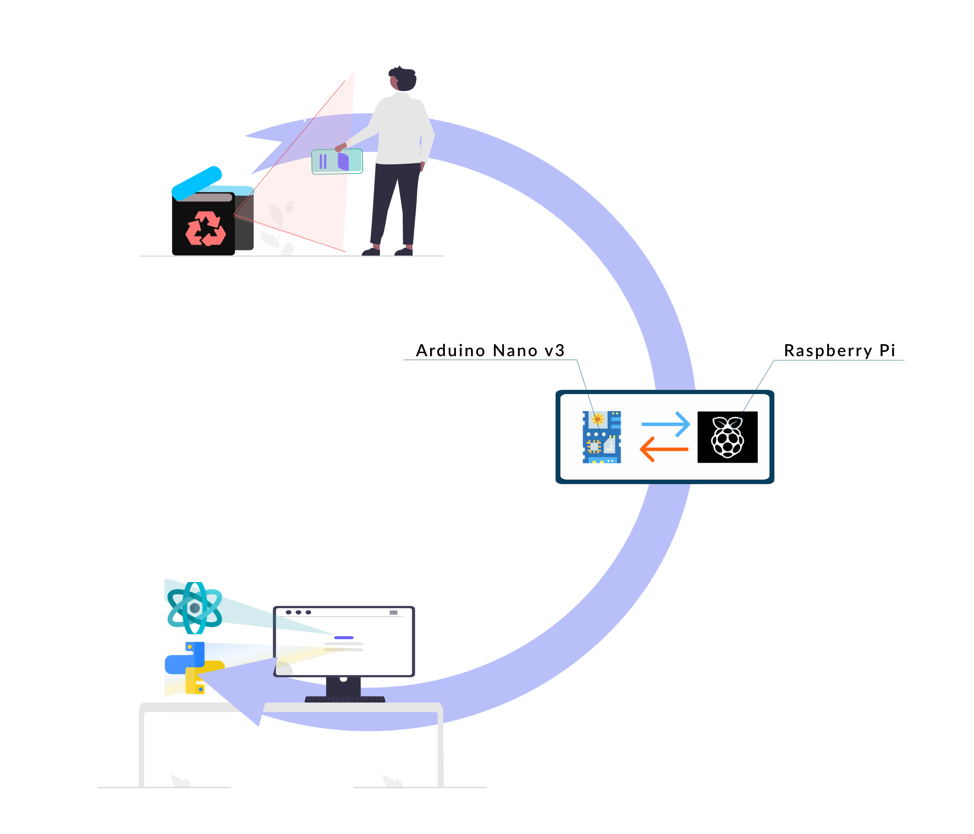
System Overview
SmartBin will open automatically once a person gets close enough
Consumer will throw his litter inside the SmartBin
On Board Cameras will analyze the thrown trash and check if it was thrown in the correct bin
A Visual confirmation will follow and if that was the case the consumer will gain or lose points in the account attached to his bin

Slide 6
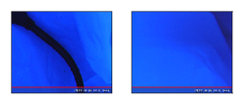
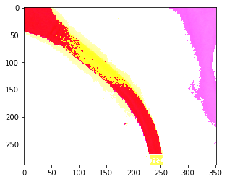
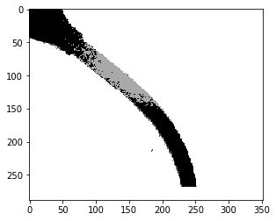
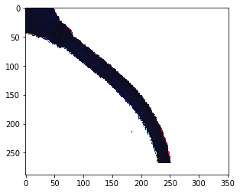
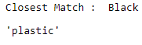
On Board Image Processing
Frame 1
Frame 0
We start by taking a picture with the on board cameras with the lighting of the led strips that are under the plastic bags
This methods relies on the assumption that most trash types comes in specific colors. For example black is linked to plastic, light blue is linked to cloth and so on. A better approach would be to use ML model which we could not implement due to the time constraint
The method compares the two frames and focus only on the changing pixels
A Mask is created and a clean version of the changed pixels will be produced
Then we can detect the dominant color and transform its RGB value to a color name and detect the material linked to it
We focus the changing pixels between the two frames
We Clean it up and turn it into a mask that will be applied to get a clean version of the changing pixels
Averaging out the colors

Slide 7
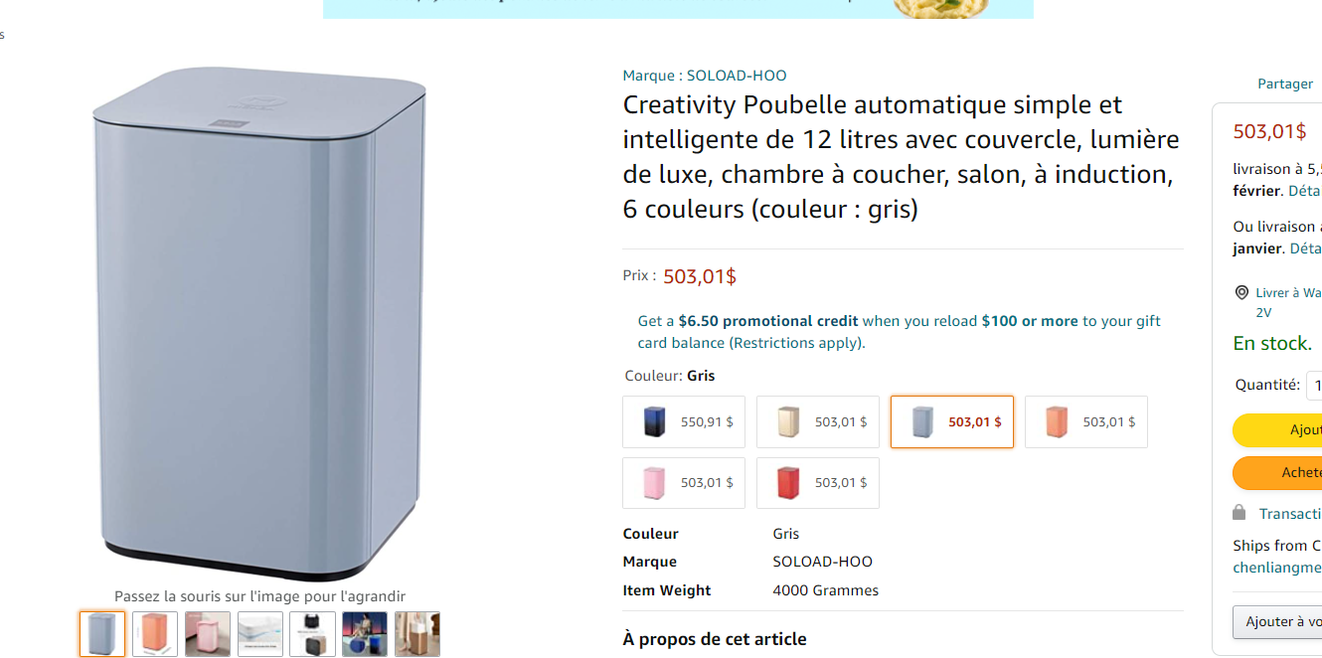
Our SmartBin vs Traditional Smart Bins
Traditional Smart Bin
Handcrafting the physical bin can take less than one hour between soldering, wiring and putting everything together.
Ours provide 2 bins one for composite and the other for recycling which most of the competition does not provide
A price for a Smart Bin that can do more than opening and closing automatically with no electrical components have a range around 140$ to 500$
Our costs 46$ if we buy items using full price. However buying and producing in bulk (more than 10 units) can bring the costs down to sub 30$
SmartBin

Slide 8
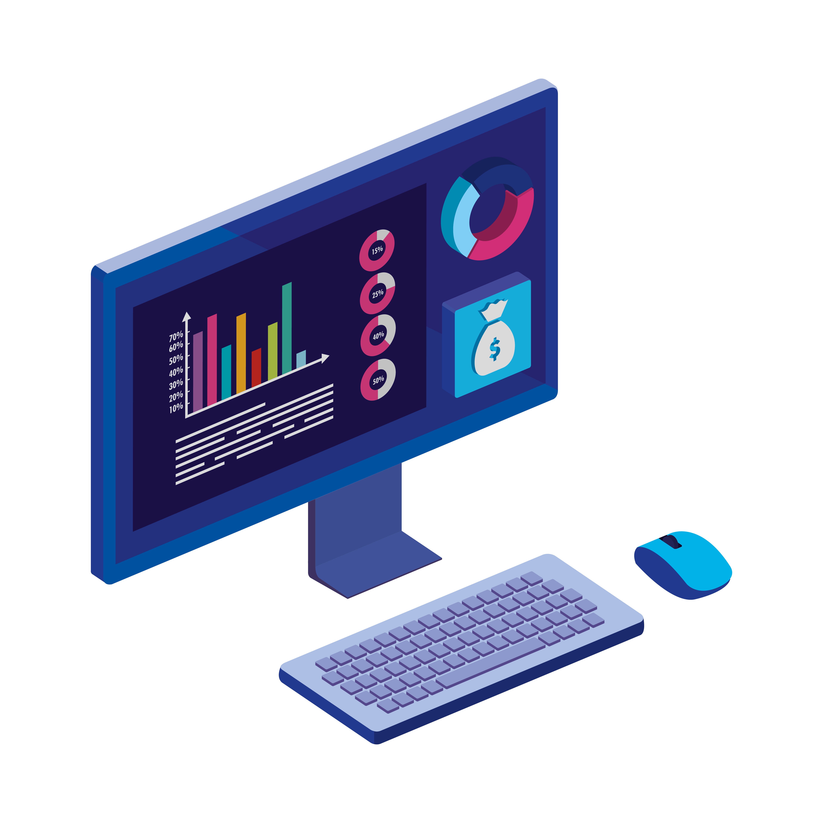
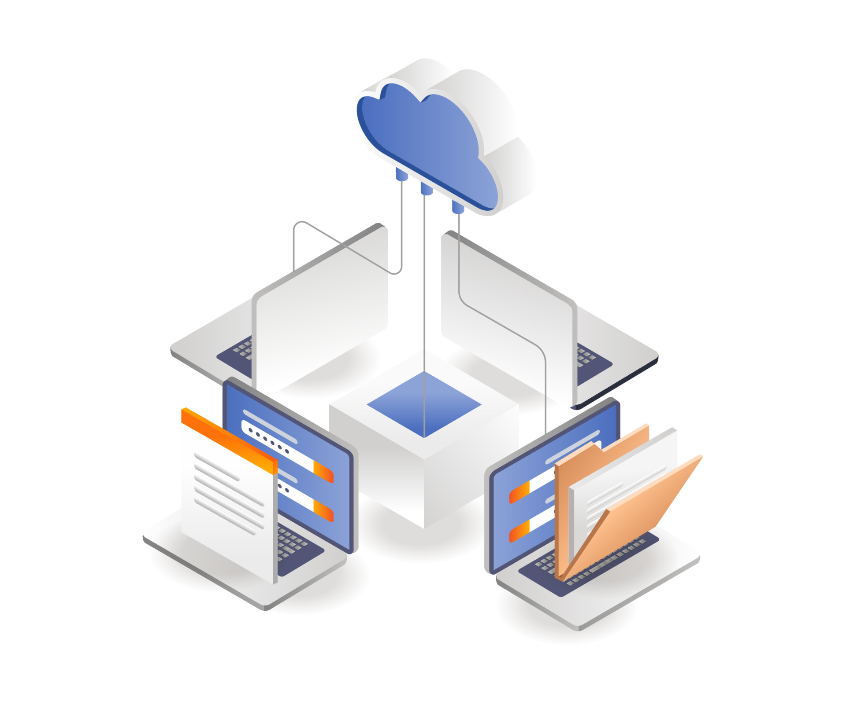
Discarding the Raspberry Pi
Method 1:
Connect the Arduino Nano to your local computer and you can execute the same script.
Please note that with minor modifications, you can connect an Arduino Nano v3.3 via Wi-Fi to your laptop
The Raspberry Pi was used to make the whole SmartBin mobile and can be stationed not necessarily close to a computer.
There are 2 alternatives to using one so the costs can stay down
Method 2:
Using an Arduino Nano v3.3 and provided that our team can provide an API, you would not even require a laptop to run the processing. This can be a future improvement to be made.

Slide 9
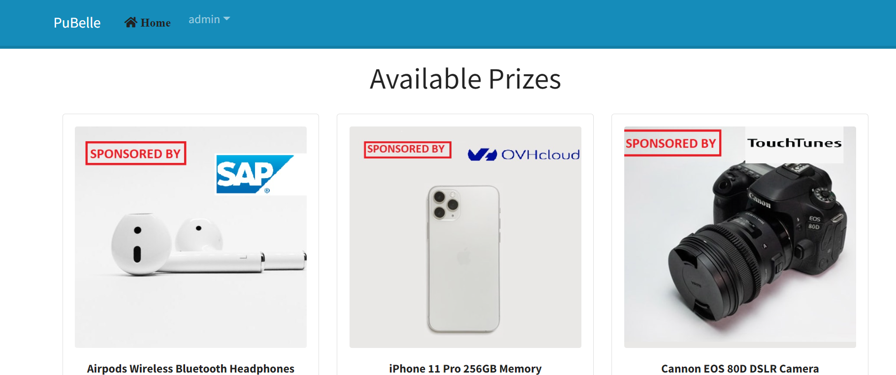

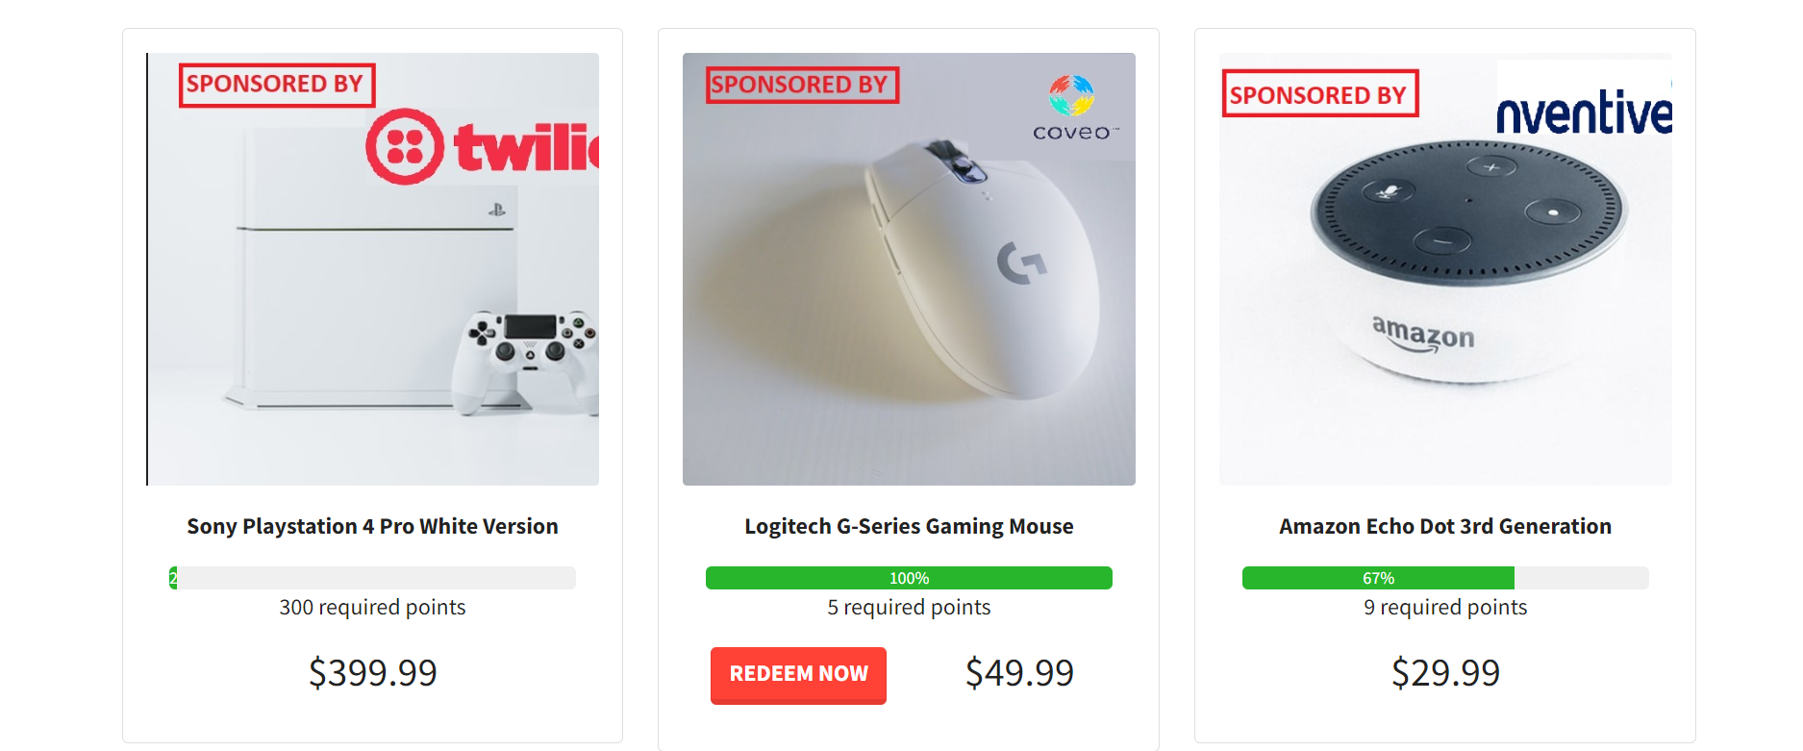
PuBelle Website
The website was create using React and Django
The points collected using the bin can be exchanged with prizes that were provided by our sponsors.
Website is already hosted:
https://pubelle.herokuapp.com/

Slide 10
PuBelle Website
The Raspberry Pi communicates with the website to add points
We are using Twilio API as well to inform users whenever they are eligible for redeeming an item

Slide 11
Costs
SmartBin Detailed costs
Component | Quantity | Link | Cost ($)
LED Strip | 2 | Dollarama | 4
Camera | 2 | Aliexpress | 9.6
Trash Can | 2 | Dollarama | 4
Arduino Nano | 1 | Aliexpress | 8
Cables | 1 | Aliexpress | 1
UltraSonic Sensor | 2 | Aliexpress | 1
Motors | 2 | Aliexpress | 1
RaspberryPi (Optional since it can be changed by a laptop or a wirless connection) | 1 | Aliexpress | 130
Total (without pi) |  |  | 46$
SmartBin COST/ UNIT
$46

Slide 12
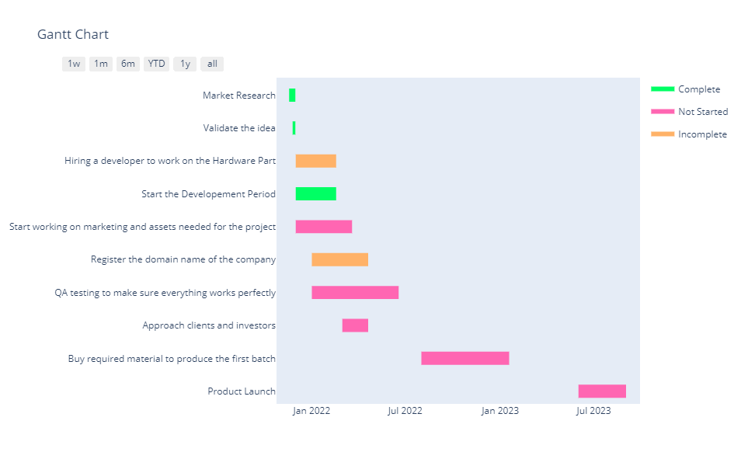
Timeline
As we can see, we are already off a great start. We already ahead of the schedule since a prototype is build
Figure 4 - Grantt Chart showing the completed tasks

Slide 13
Future improvement:
Deploy an ML based model for trash classification
Create a mobile app version of the website
Discard the Raspberry Pi approach and use a dedicated API with a Nano v3.3 that comes with Wi-Fi

Slide 14
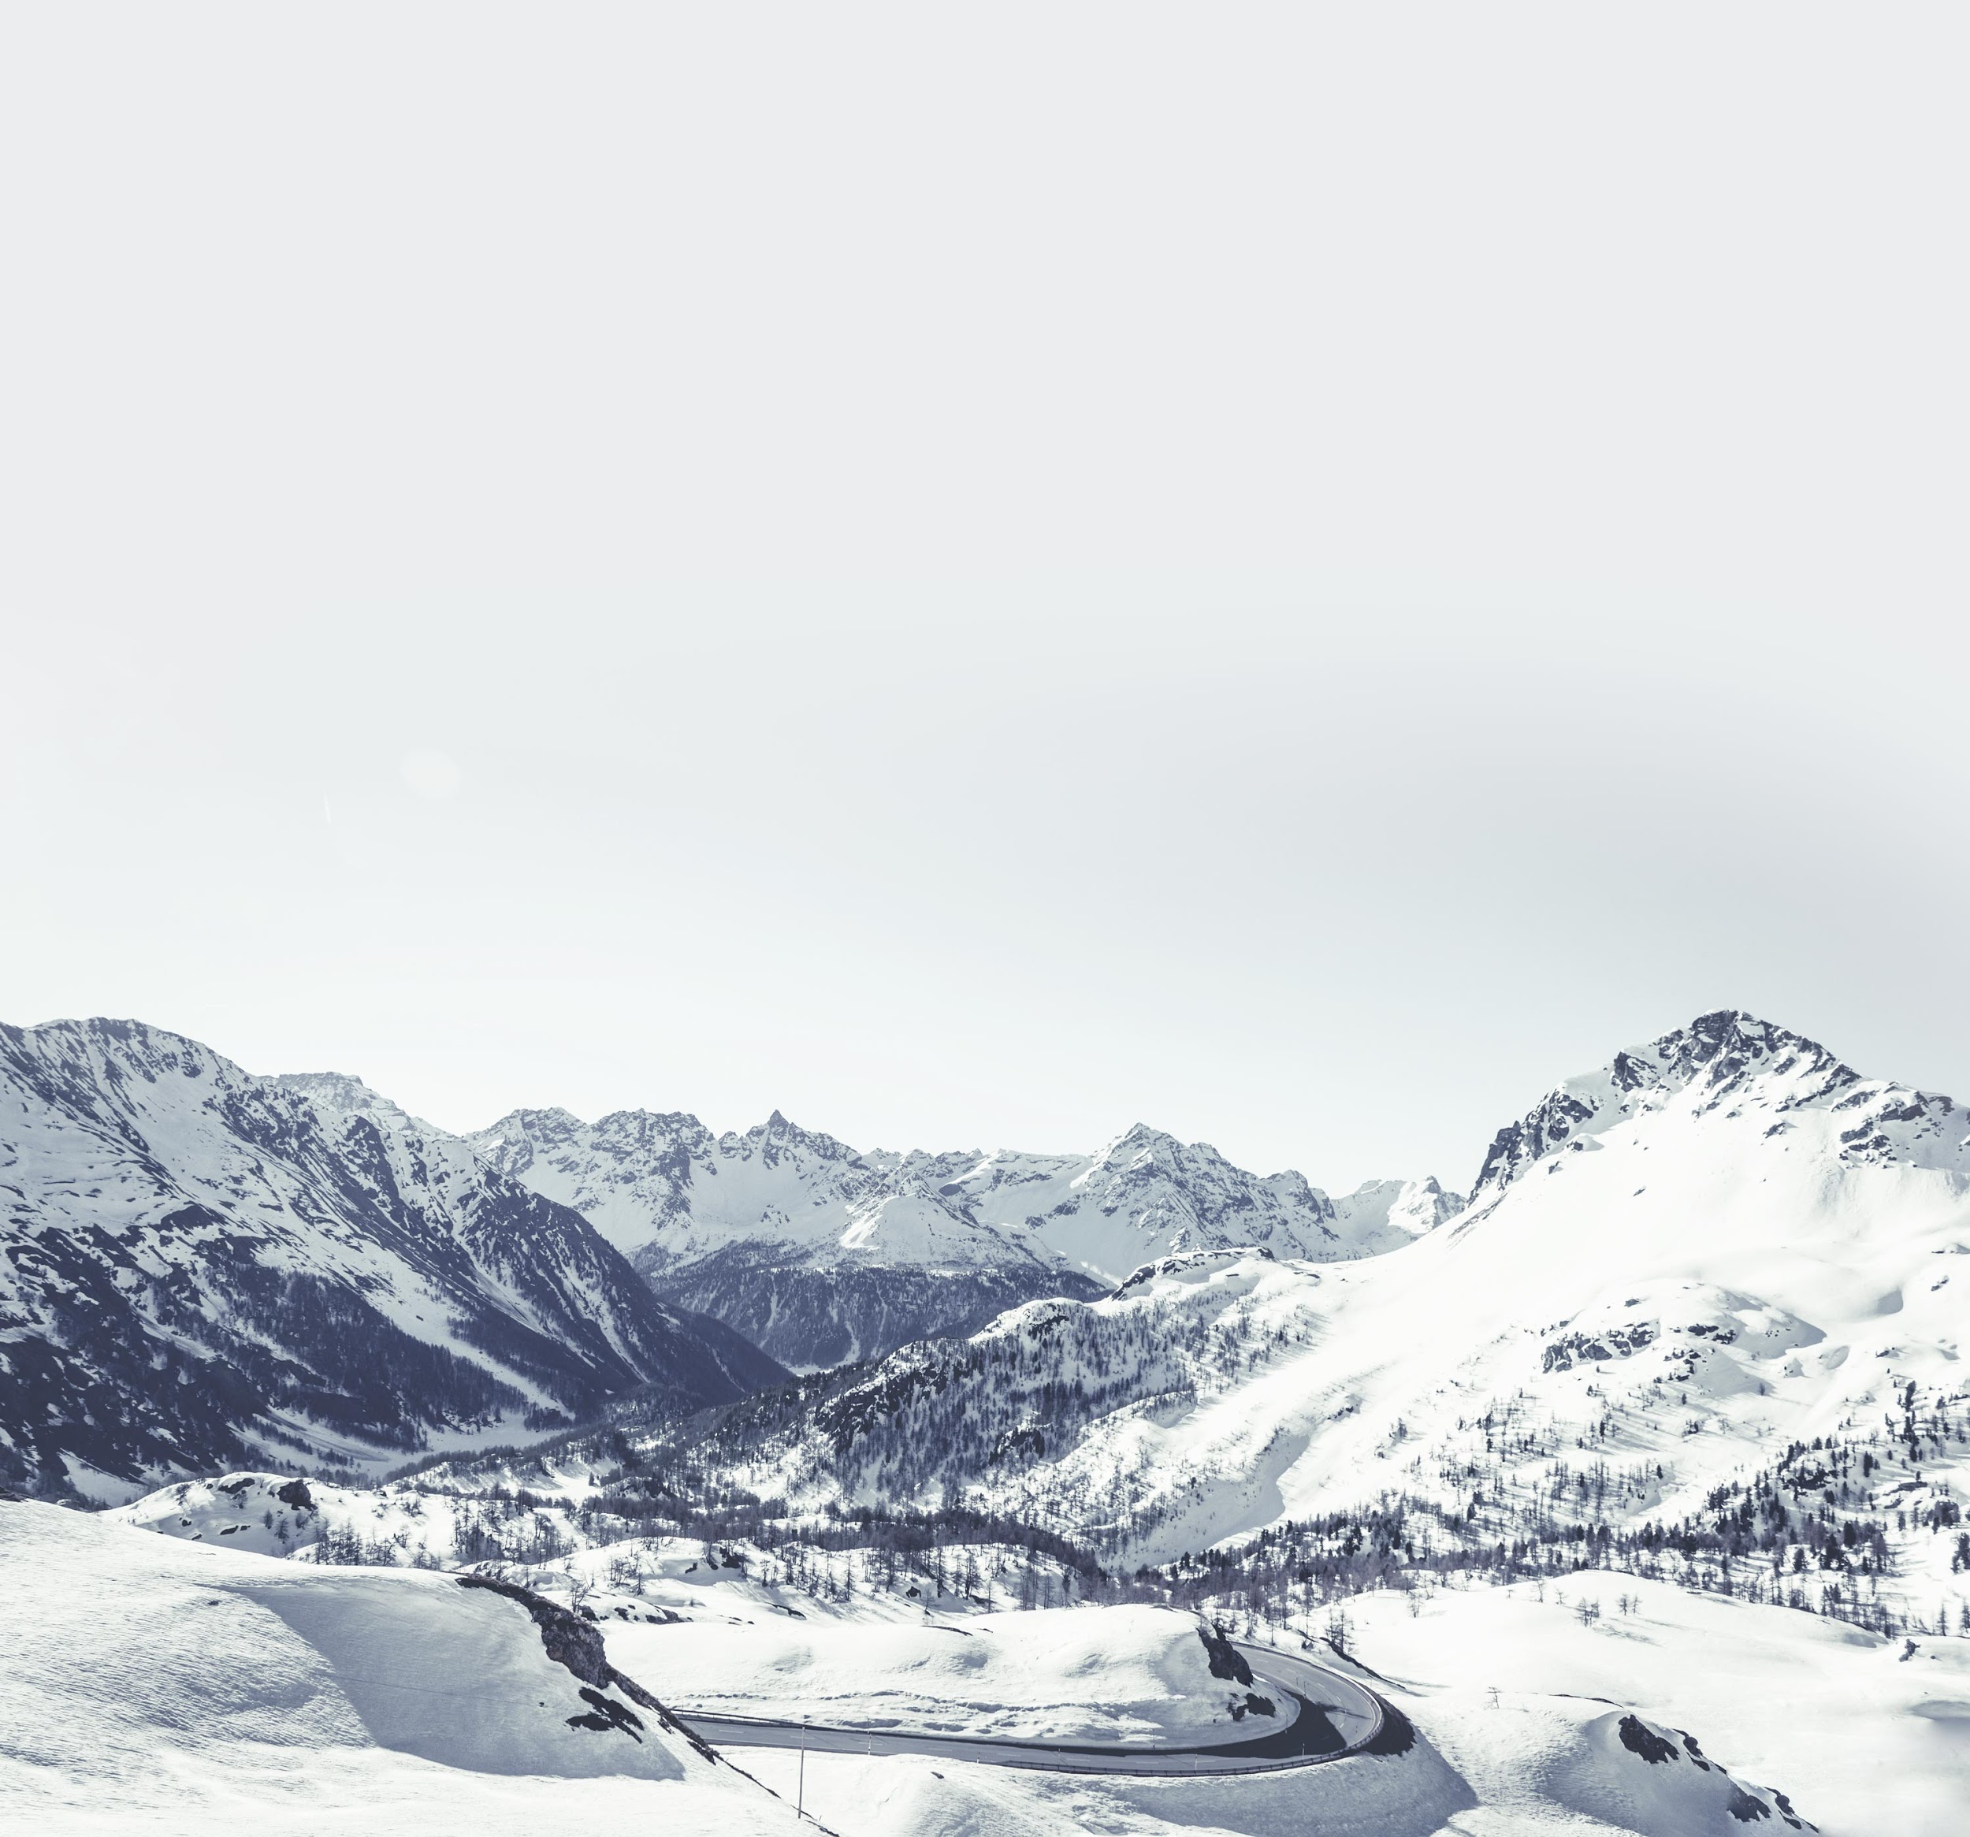
Summary
Traditional Smart Cans | Our proposed SmartBin
Very Expensive You need to buy two No incentive to pay attention for recycling Most current designs are outdated No website or any tracking app that comes along | Quick Cheap Comes with more features Was designed with state-of-the-art technologies

Slide 15
Conclusion
With all the evidence and extensive research that was done on the topic. Our proposed approach show a significant superiority when it comes to cost, efficiency and accuracy compared to competition. Moreover, this work can be beneficial for the community as a whole and its potential exceeds the discussed problem which can be a great point for future R&D.

Slide 16
THANK YOU

